Slide 1
Introduction
Title of Unit: Would You Survive?
By: Jaclyn Jones
School: Loveland High School
Course: Honors Biology
Number of Students: 95

Slide 2
Big Idea and Essential Question
Big Idea- interdependence, sustainability and critical thinking skills to survive in an ecosystem.
Essential Questions-
How would you survive?
Would you survive?
How can we life a sustainable life while in this ecosystem?
How do my actions impact the ecosystem I am in? What types of materials do I need to live?
*The main theme is… How would you survive?

Slide 3
What is the Challenge?
Challenge-
Survival in a unknown location for a 2 week stay with prior background knowledge and a self made survival kit.
Samples of some Guiding Questions-
-temperature?
-water availability?
-food availability?
-what is going to be your shelter?
-dangers you may come across (ie. Animals who are poisonous, predators, are you living in a war zone)
-you only can pack so much in your bag, so what are the most important items you need?

Slide 4
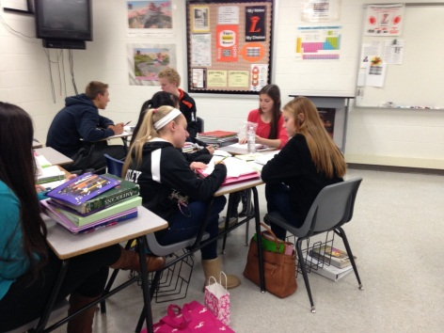
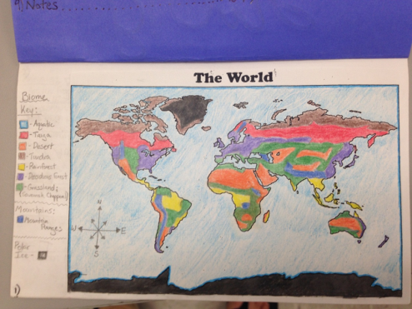
Activities
Lesson 1 will focus on gaining student interest to prepare them for the research and they challenge which follows.
Activity #1: Cry in the Wild video and worksheet to gain student interest on survival in a remote location.
Activity #2: Plane Crash Activity. Students work in groups to critical think and solve the problem of being stranded.
Lesson 2 will focus on the research of each biome.
Activity #3 is having students research all of the biomes (especially for the OGT) they will engage in research by making a biome booklet.
Activity #4 is to build a survival kit based on your location. This is where students will begin the challenge for this unit. They will be developing a survival kit to help them stay alive for a two week stretch in the biome they will be stranded.

Slide 5
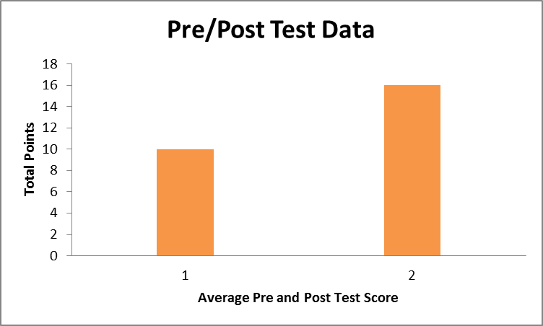
Evidence of Student Learning

Slide 6
ASC
A-Relate previous knowledge to a specific location to come up with a survival plan.
C-Environmental Engineering, Conservation Engineering, Medical Engineering
S- Global relevant fields such as global warming, technology, sustainability, and critical thinking on how to solve environmental issues in the world or specifically areas around them.

Slide 7
Reflection
The Good:
Students were really involved and loved the lesson, I received really good feedback.
Students met the objectives of the unit and all lessons.
Students were able to work together and really analyze the challenge put in front of them. They worked well solving problems and working as one.
The Bad:
This unit took a lot of time, I will have to condense it next time.
I had to change some of my locations for my challenge because they were “too remote” or “not remote enough” to have the students properly work on the project and meet all of the requirements.

